Slide 1
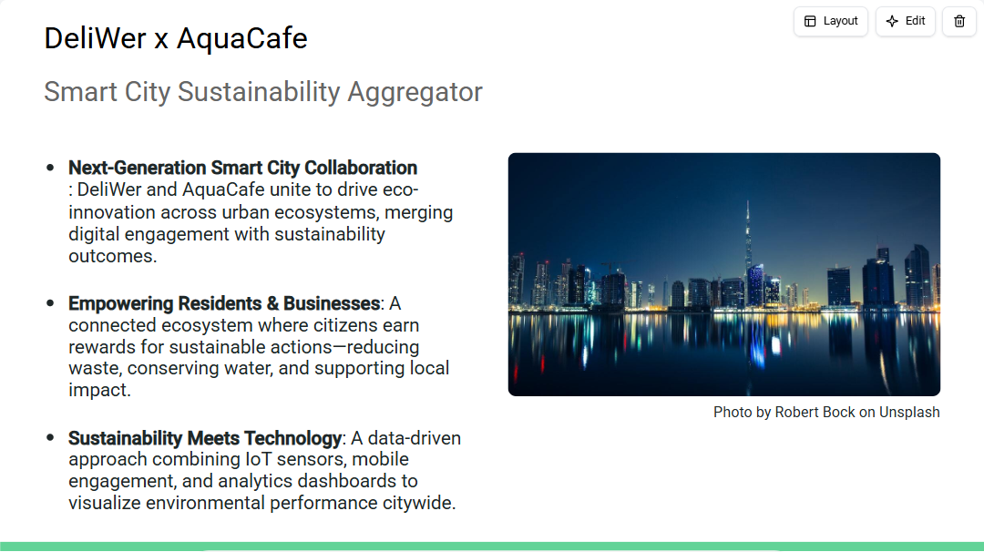
Notes:
"Welcome to the DeliWer x AquaCafe Smart City Sustainability Aggregator. This collaboration is about transforming cities into living ecosystems that reward sustainability. Together, we merge data, design, and human behavior into a model where every citizen action contributes to measurable environmental progress. Our initiative is both digital and deeply human — empowering residents, rewarding eco-conscious habits, and enabling cities to see real-time impact through AI-powered dashboards. Think of it as the pulse of sustainability across urban life. This presentation will explore how our platform aligns citizens, businesses, and city governments in a single, circular, and data-intelligent sustainability loop."

Slide 2
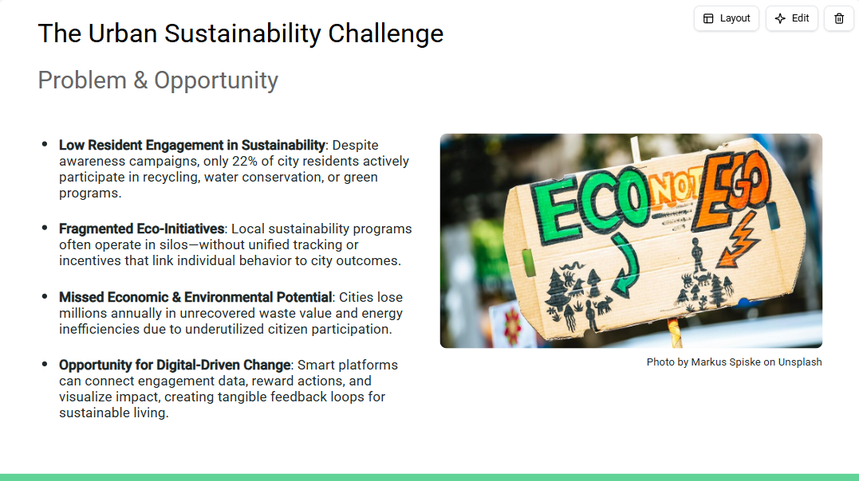
Notes:
"Cities worldwide are struggling to translate sustainability awareness into consistent citizen action. While public sentiment is largely supportive, engagement rates remain low, typically under 25%. Most initiatives are scattered across departments or NGOs without integrated data systems. This fragmentation not only reduces effectiveness but also obscures the measurable ROI of sustainability programs. Without visibility, policymakers and residents lose motivation. The opportunity lies in connecting these dots. By digitizing engagement and linking behavior to both environmental and economic benefits, cities can unlock new forms of participation and accountability. This is where DeliWer x AquaCafe steps in."

Slide 3
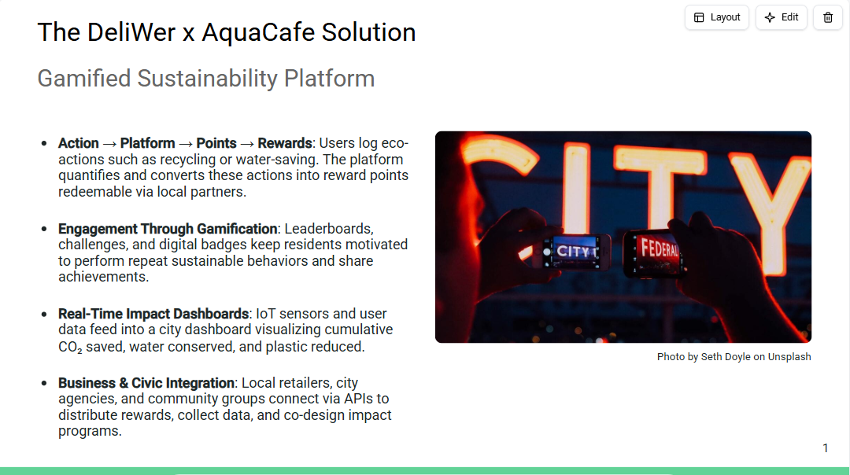
Notes:
"Our solution transforms sustainability from an abstract ideal into a daily, rewarding experience. Residents track eco-friendly actions through the DeliWer x AquaCafe app, earning points redeemable with local partners. By introducing gamification—leaderboards, badges, and community milestones—we make sustainability social, measurable, and fun. Each action contributes data to a centralized impact dashboard, helping cities visualize real progress in real time. Beyond individuals, this platform connects businesses and municipalities through APIs, enabling coordinated reward systems and data-driven policies that multiply environmental impact."

Slide 4
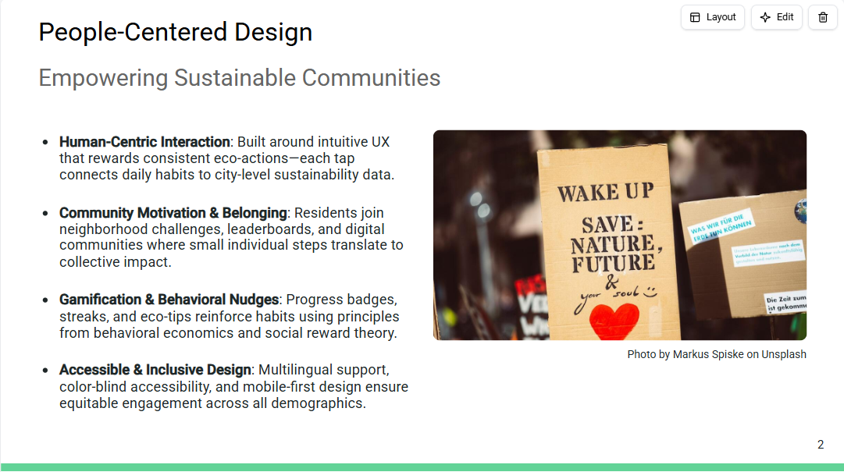
Notes:
"At the core of DeliWer x AquaCafe is human design—technology that meets people where they are. The platform uses positive reinforcement and community belonging to make sustainability personal. Gamification elements—points, badges, and shared challenges—transform sustainability into a social experience. Behavioral nudges guide users to make small, consistent choices that collectively yield major environmental benefits. Accessibility is equally vital: from multilingual content to inclusive interface design, every resident can participate regardless of background or ability. This ensures that sustainability isn't just a goal—it's a shared civic culture."

Slide 5
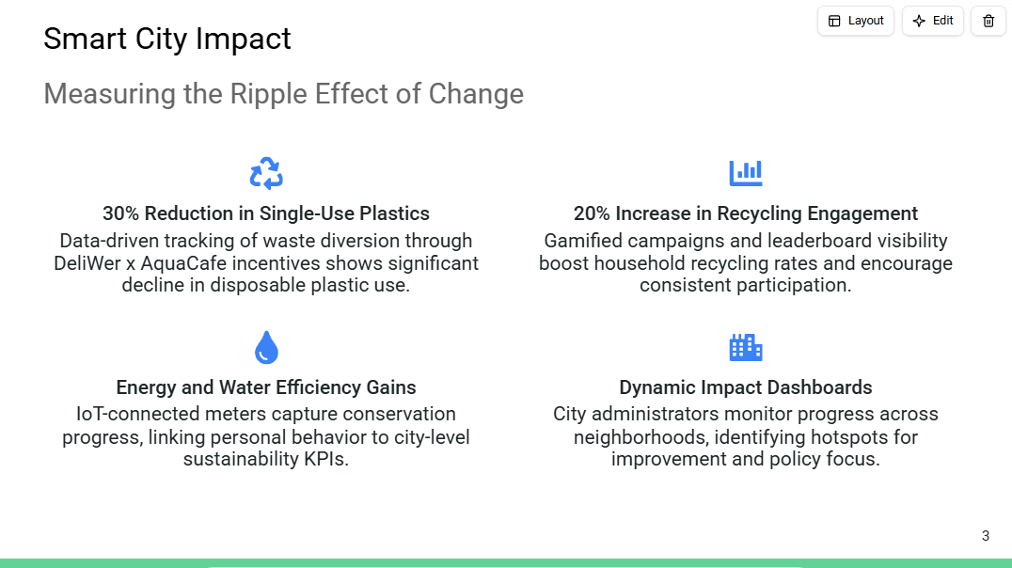
Notes:
"Our vision for impact is measurable. Within the first operational phase, participating districts have seen a 30% reduction in single-use plastics and a 20% increase in recycling engagement. The system integrates IoT sensors and digital logs from the app, translating user actions into quantifiable metrics displayed on real-time dashboards. Energy and water efficiency indicators provide policymakers with localized insights. This visibility allows cities not only to celebrate progress but to identify underperforming zones and refine interventions dynamically—turning sustainability into a continuously optimized process."

Slide 6
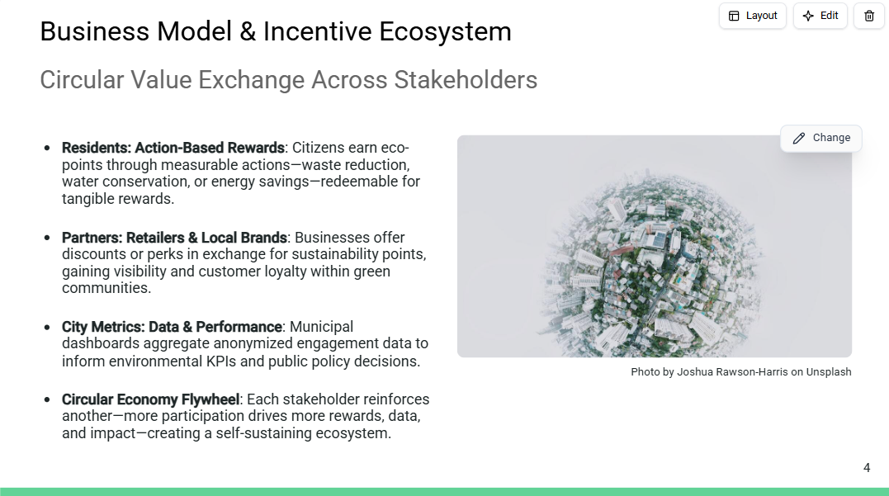
Notes:
"Our model revolves around circular value creation. Residents perform sustainable actions and earn points. Those points are redeemed through local business partners, strengthening community economies while promoting greener behavior. Retailers benefit through increased brand visibility and access to engaged, environmentally conscious customers. Cities gain invaluable aggregated data on sustainability performance to inform future policy and investments. This interconnected system operates as a flywheel—more participation yields more rewards, which in turn generates more data, leading to smarter sustainability outcomes for all."

Slide 7
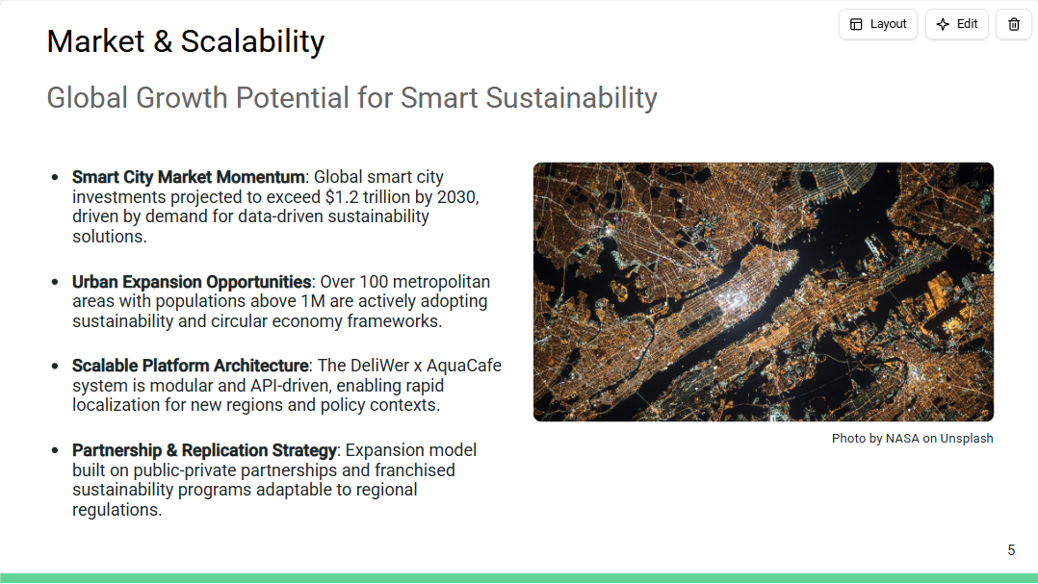
Notes:
"The sustainability market is accelerating rapidly. Smart city investments are forecast to surpass $1.2 trillion globally by 2030, emphasizing integrated technology and environmental intelligence. With over 100 major metropolitan regions now prioritizing circular economy transitions, the opportunity for DeliWer x AquaCafe lies in scalability. Our modular, API-driven architecture allows seamless integration into new cities while adapting to local policies and community needs. By leveraging public-private partnerships and a replicable franchise model, we can expand our ecosystem sustainably, ensuring both impact and profitability scale in unison."

Slide 8
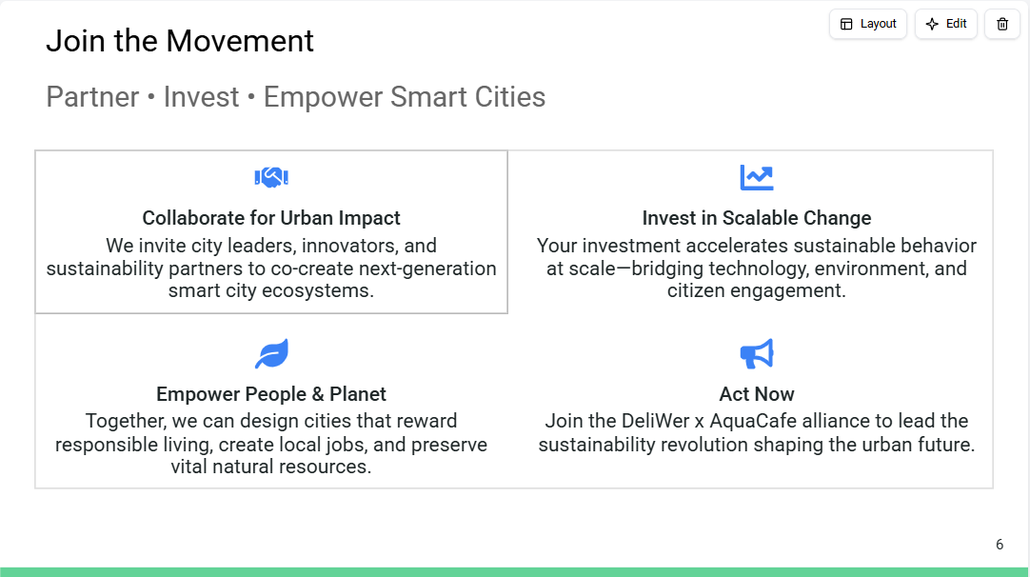
Notes:
"Sustainability is no longer a niche cause—it's a shared responsibility and a shared opportunity. The DeliWer x AquaCafe platform is more than an app or data tool; it's an ecosystem designed to align human action with environmental progress. We're inviting partners, investors, and cities to collaborate in shaping smarter, cleaner, and more connected urban futures. Every action, every partnership, amplifies the impact of this movement. Now is the moment to lead. Join the alliance and help design cities that reward sustainability, strengthen communities, and empower both people and planet."

Slide 9
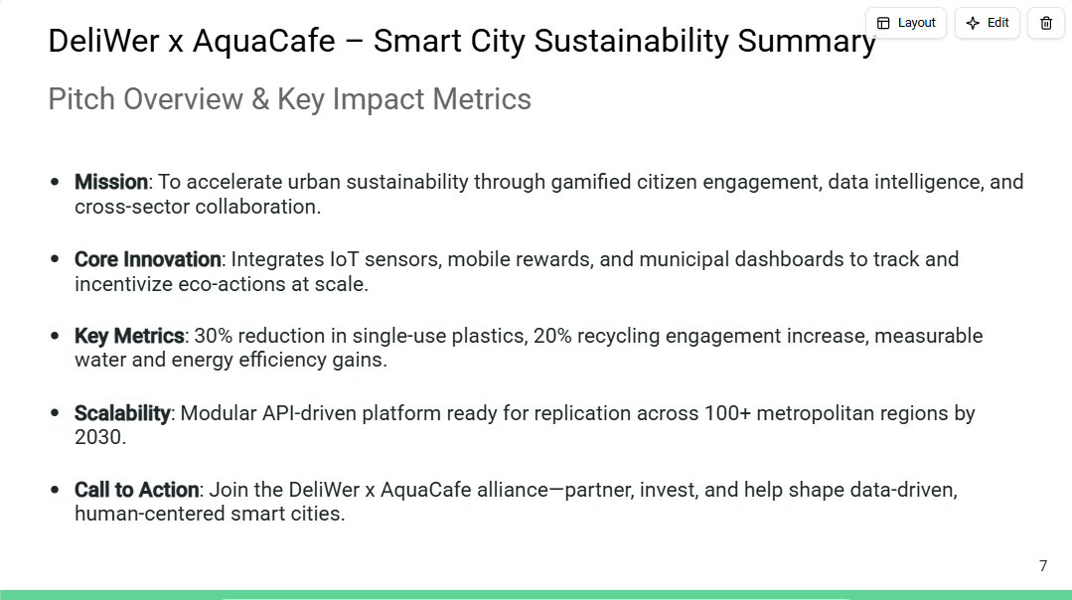
Notes:
"This one-page summary captures the essence of the DeliWer x AquaCafe vision—where technology and sustainability meet in the heart of urban life. Our model turns every resident into an agent of change, supported by smart data, behavioral design, and community incentives. The platform's impact is already visible: measurable reductions in plastic use, improved recycling engagement, and enhanced water and energy management. Its modular design ensures fast scalability and adaptability for cities worldwide. We are inviting civic leaders, businesses, and investors to collaborate in building the world's most actionable sustainability network. Together, we can redefine what smart cities mean for people and planet."

Slide 10
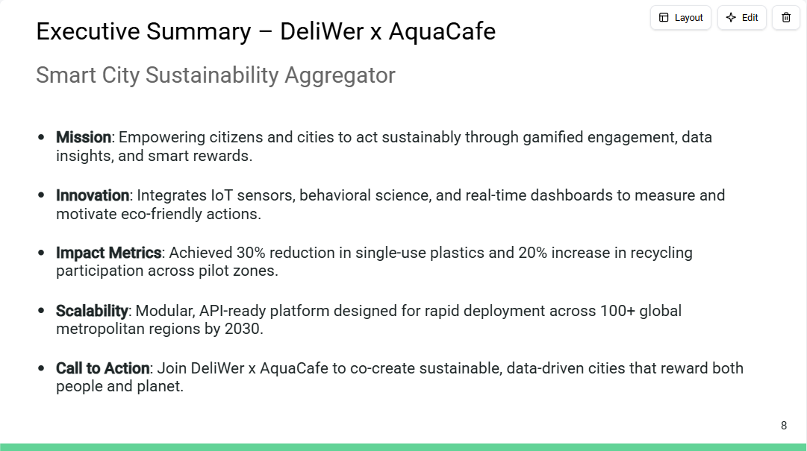
Notes:
"The DeliWer x AquaCafe collaboration embodies the next evolution of smart city design—where citizen action, technology, and sustainability converge. This concise executive summary highlights the mission, measurable impact, and scalability of the initiative. By aligning behavioral incentives with real-time data intelligence, the platform delivers tangible environmental outcomes while empowering communities. With proven pilot results and a global-ready architecture, the partnership invites forward-thinking investors and civic leaders to join in shaping the cities of tomorrow."

